Slide 1

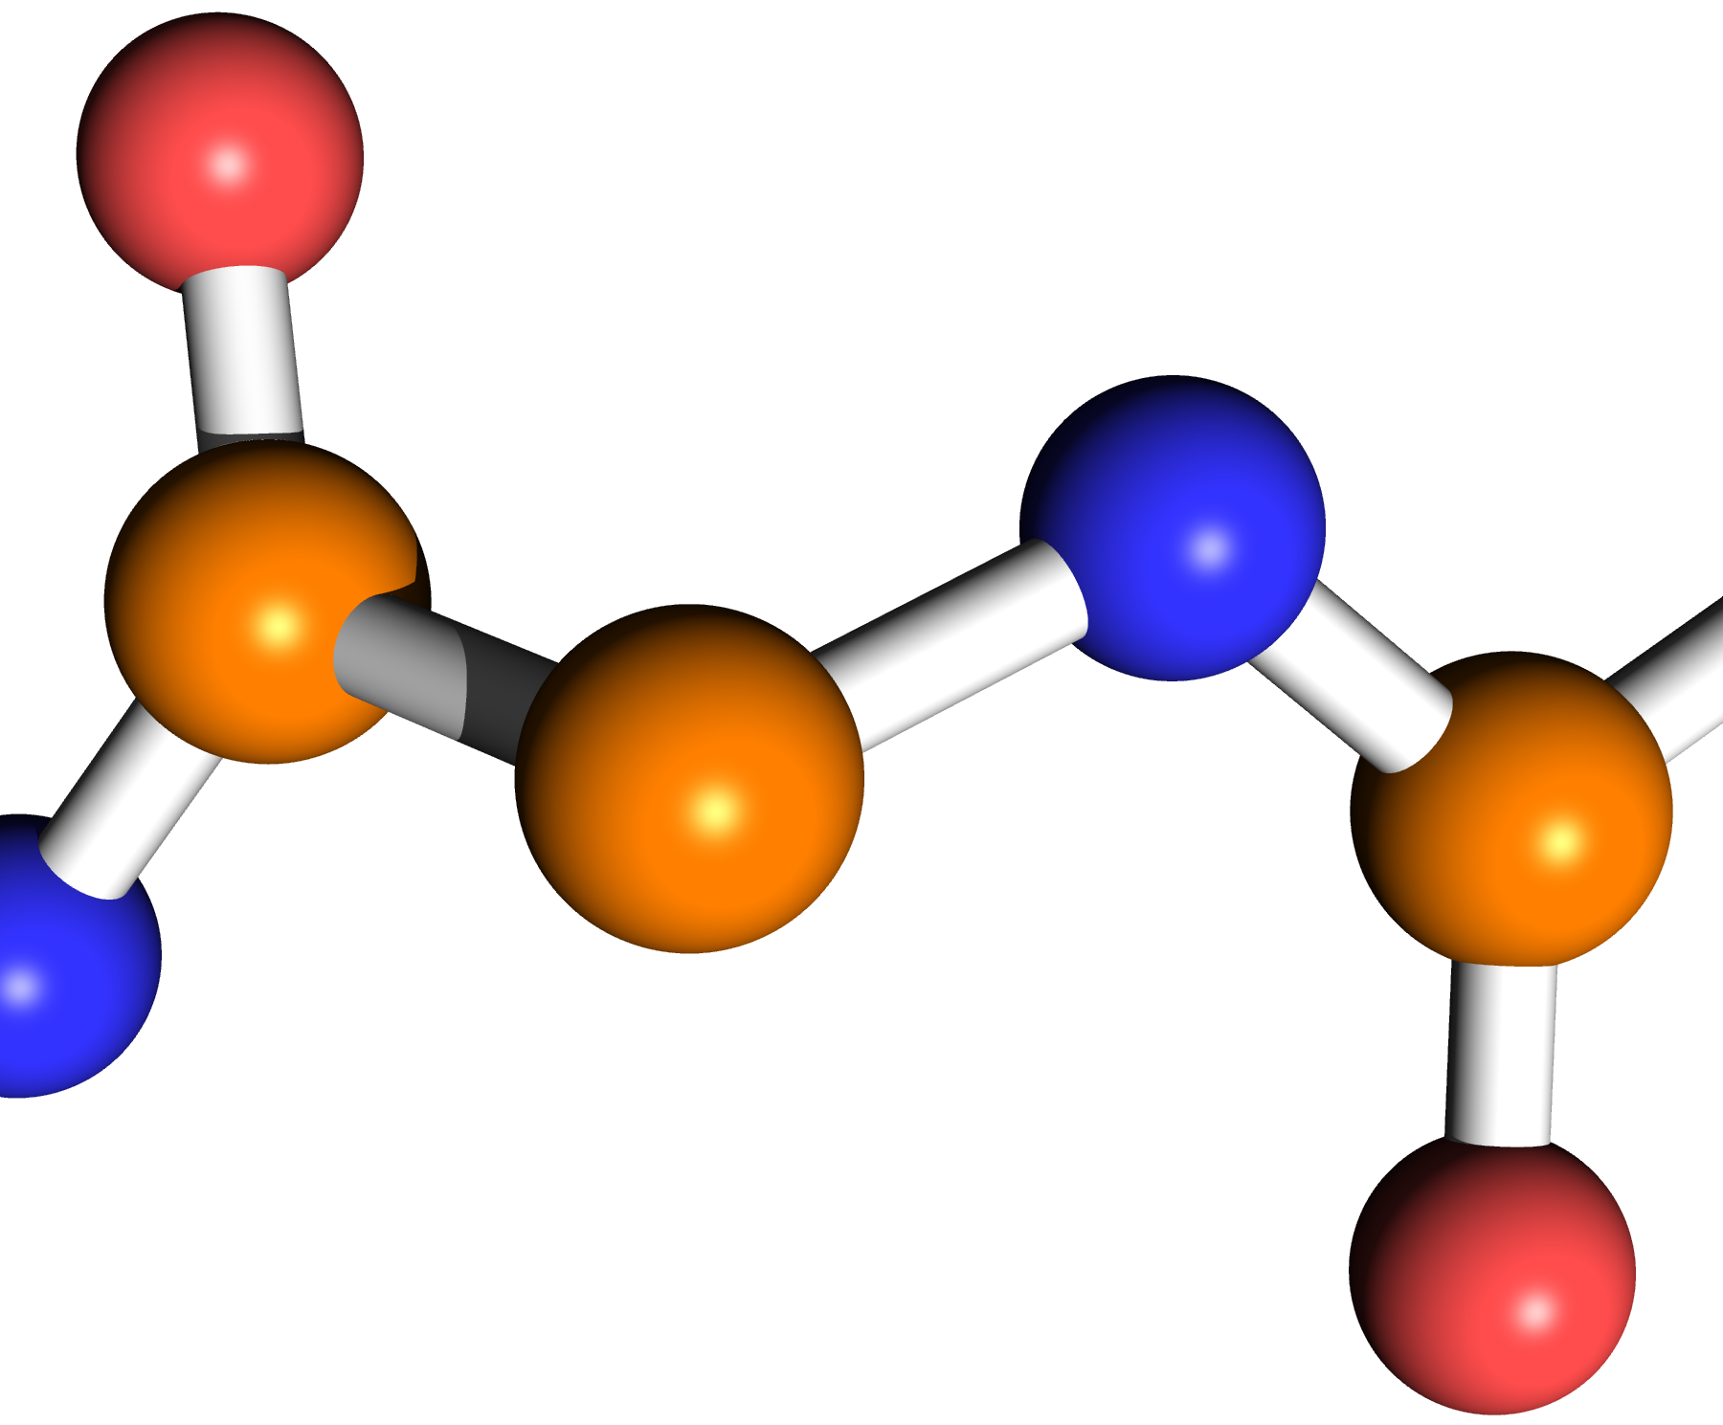
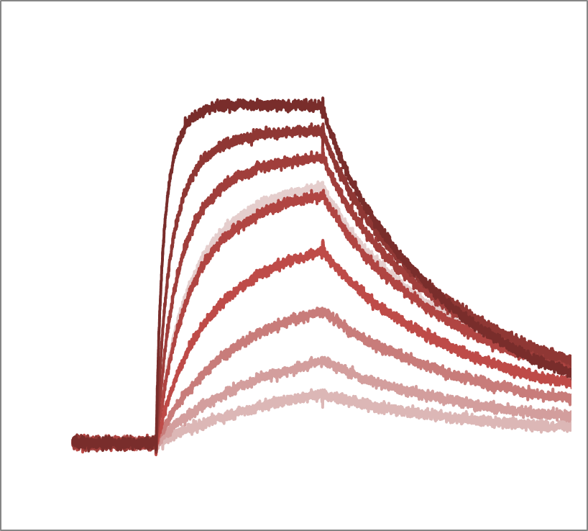
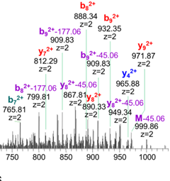
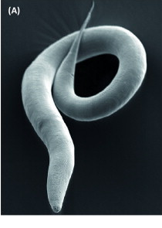
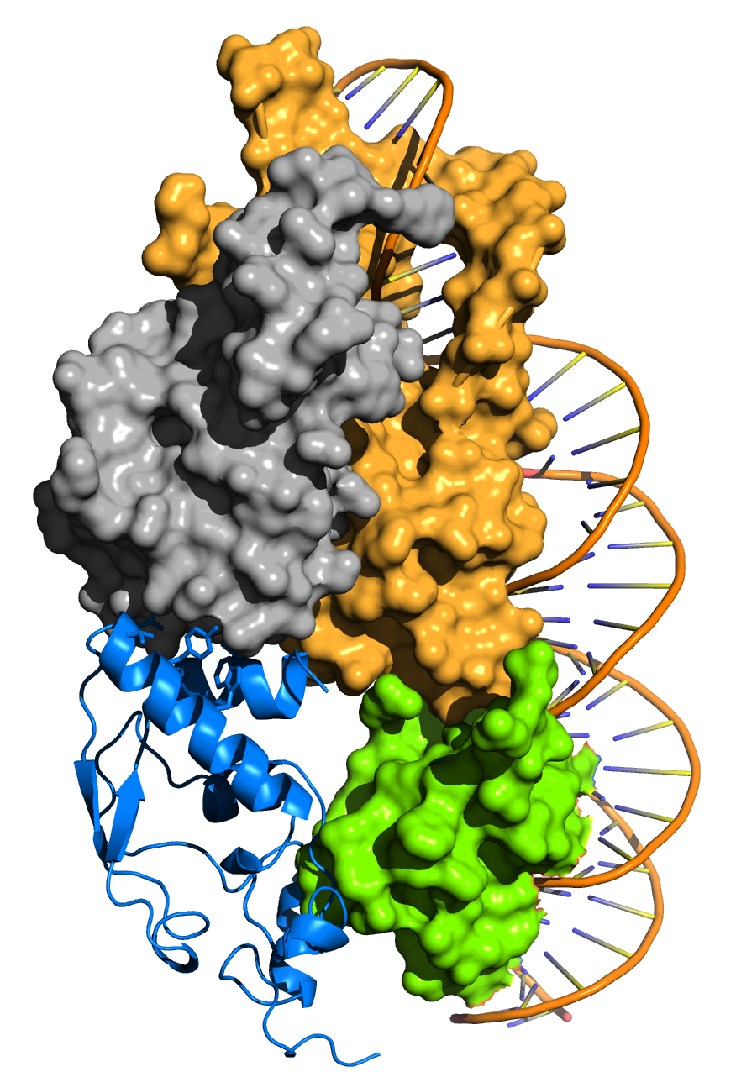
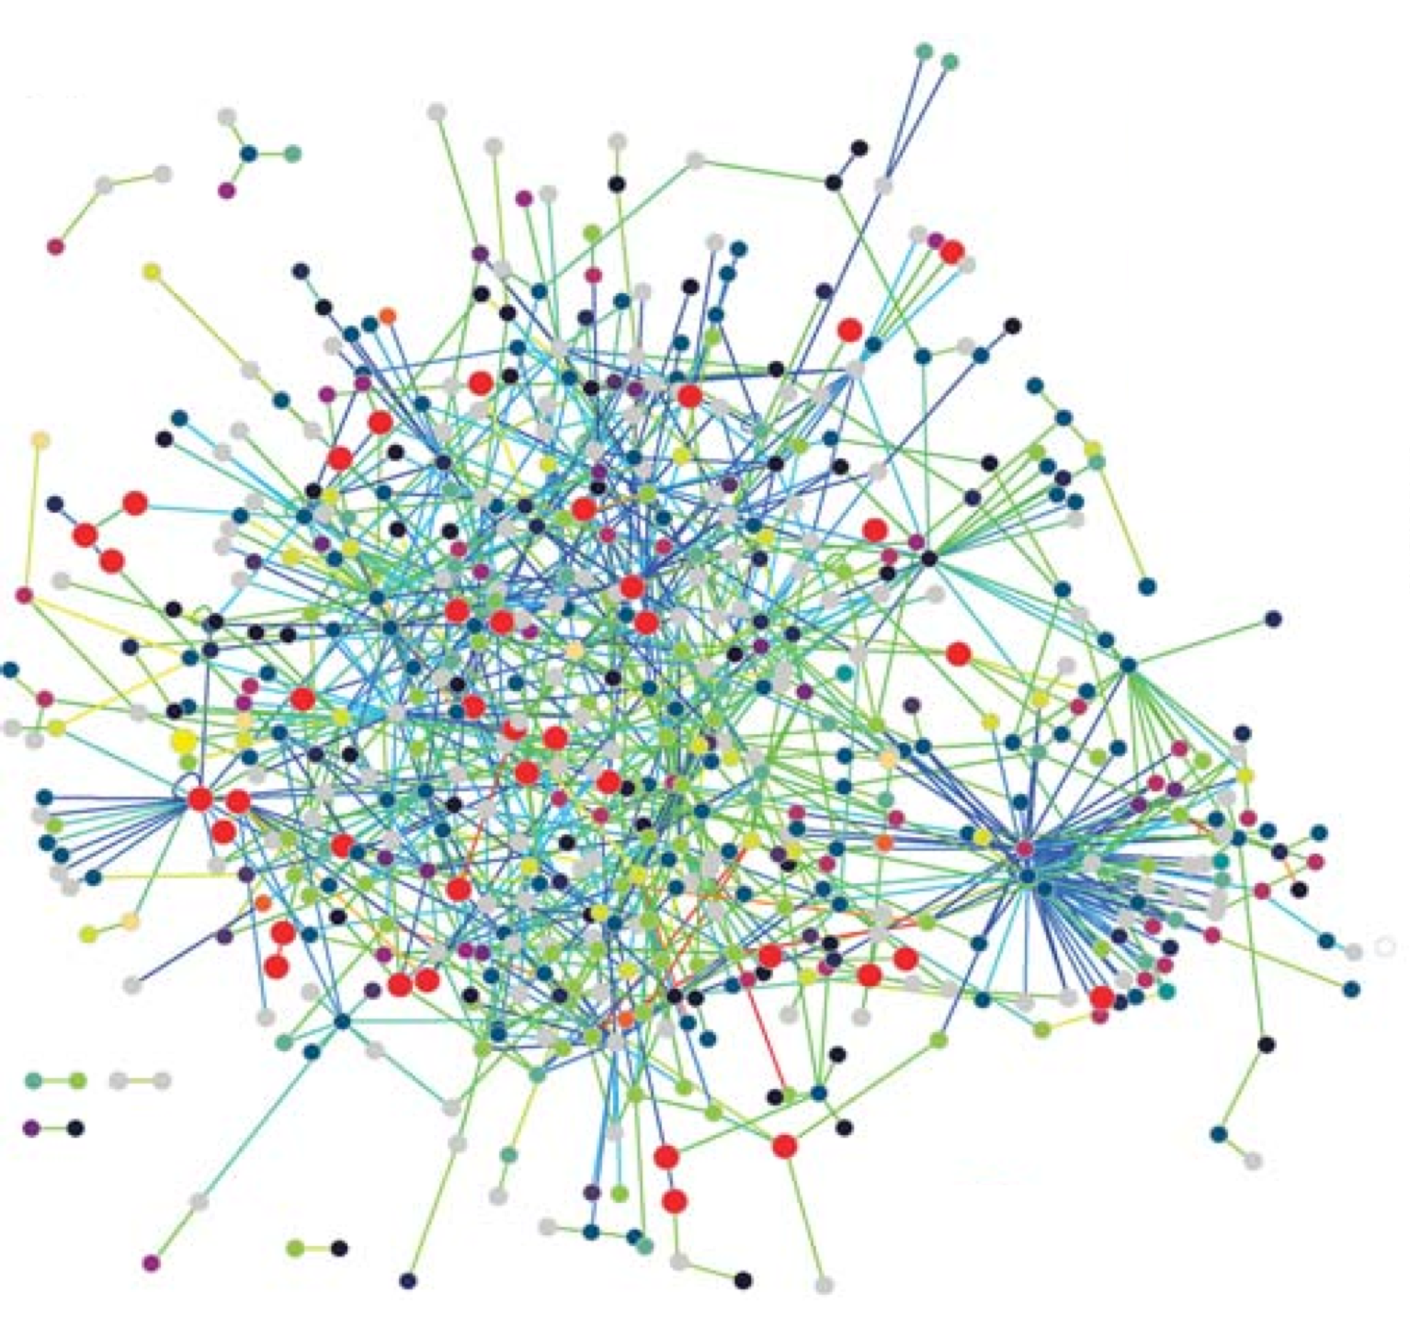





9th annual scientific meeting
Boost your research with some protein
intake: Multi-scale approaches to protein
structure and function
June 6, 2016
Domaine Saint-Joseph
Sainte-Foy-lès-Lyon
External Speakers
Gabriel Waksman
Institute of Structural and Molecular Biology, London
Jonathan Ewbank
Centre d'Immunologie de
Marseille-Luminy
SFR Speakers
Catherine Moali (LBTI)
Karine Monier (LJC)
Charlie Scutt (RDP)
Kiran Padmanabhan (IGFL)
Nushin Aghajari MMSB)
Patricia Doublet (CIRI)
Saw See Hong (IPVC)
Martin Spichty (LBMC)
SFR R&D
Flash presentations
Free registration at: http://www.sfr-biosciences.fr/animation/Colloques/2016

